Slide 1

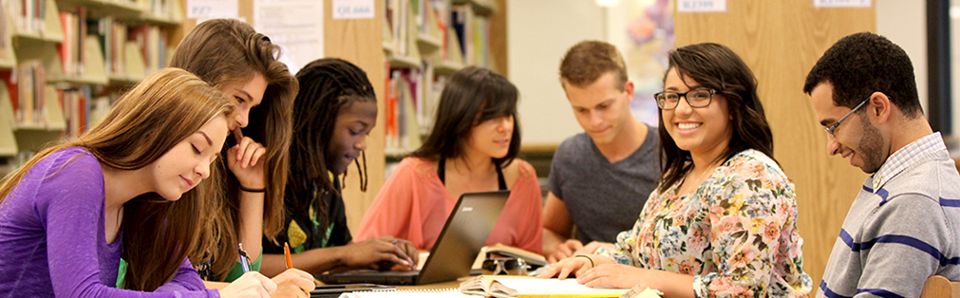
SJR State Collegiate High Schools in St. Johns County
Parent/Student Information Sessions
Monday 2/5/18, 6pm Nease High School
Tuesday 2/6/18, 6pm Pedro Menendez High School
Wednesday 2/7/18, 6pm Creekside High School

Slide 2








Welcome
SJR State & St. Johns County
School District Collaborative Partnership
St. Johns River State College
St. Johns County School District & High Schools

Slide 3

The Basics
Who is SJR State?
What is the Associate in Arts Degree?

Slide 4

What is a Collegiate High School?
The SJR State Collegiate High Schools in St. Johns County create an opportunity for a cohort of eligible students to enroll in college level classes and earn their Associate in Arts degree—all while still enrolled in high school.

Slide 5
Aren’t our students already doing this?

Slide 6
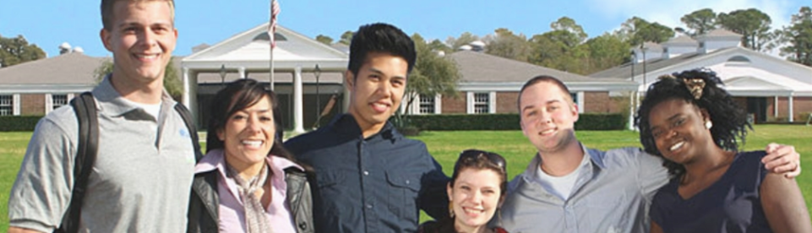
What is a Collegiate High School?
PATHWAY TO THE AA DEGREE
10th & 11th grades: students will take a defined list of 18 college credits in combination with their high school classes.
Summer between 11th & 12th grade: students will take 9 college credits at SJR State or online.
12th grade: students will be enrolled full time on the St. Augustine Campus of St. Johns River State College, taking a total of 33 credits.

Slide 7
Who Is Eligible?
Participation in Dual Enrollment in Florida requires a minimum of 3.0 un-weighted high school GPA.
Students were selected to receive an invitation to today’s information session based upon having a minimum un-weighted cumulative high school GPA of 3.0.
Strong performance in English, Reading, and Math courses recommended.
Students must have a level 3, 4 or 5 on the 8th grade Florida Standards Assessment for English Language Arts.
Eligibility dependent upon final 9th grade end of year GPA.

Slide 8

How Would This Work?
Documents in Packet
SJR State Associate in Arts Degree
SJR State Collegiate High School Associate in Arts to Baccalaureate Degree Pathway
Principles of Participation
Admissions & Lottery Process
Lottery Application

Slide 9
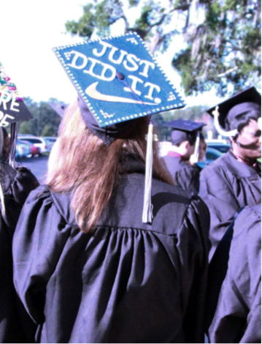
Nuts & Bolts
All students must have and maintain a minimum of a 3.0 un-weighted high school GPA and in all dual enrollment courses earn an A, B, or C (No Ds, Fs, or Ws) for continued program eligibility.
  As part of the application process, students will complete a college readiness test to assess their readiness in college reading, writing, and math.

Slide 10
Nuts & Bolts
Students must be engaged in college preparatory curriculum throughout high school and showing signs of increased college readiness in order to continue to participate each year.
Students must have college ready test scores in math, reading, and writing in the 11th grade in order to be on track to graduate from high school with the AA Degree.
College Ready Test Scores
ENC 1101 Composition I | ACT: 19 Reading & 17 English Old SAT: 440 (tests prior to March 2016) New SAT: 440/24 (effective March 2016) PERT: 106 Reading & 103 Writing CPT: 83 Reading & 83 Sentence Skills
MAT 1033 Intermediate Algebra | ACT: 19 Math Old SAT: 440 (tests prior to March 2016) New SAT: 480/24 (tests after March 2016) PERT: 114 Math CPT: 72 Elementary Algebra
MAC 1105 College Algebra | Completion of MAT 1033 OR ACT: 21 Math Old SAT: 450 (tests prior to March 2016) New SAT: 490/25 (tests after March 2016) PERT: 123 Math CPT: 85 Elementary Algebra

Slide 11
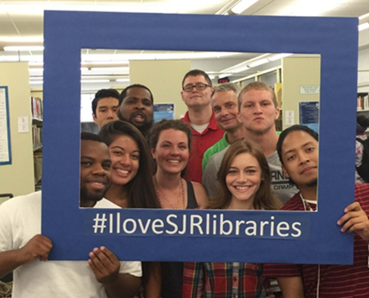
Nuts & Bolts
Tenth grade courses will be offered at the high school.
In the 10th Grade as part of the course SLS 1101, all Collegiate High School students will come to SJR State’s Campus for a tour, overview of campus services, and to obtain student ID cards.
Collegiate High School students are eligible to access SJR State’s library and Academic Support Center throughout grades 10-12.
Collegiate High School students will be regularly scheduled to meet with SJR State Dual Enrollment Specialists and Academic Advisors.

Slide 12
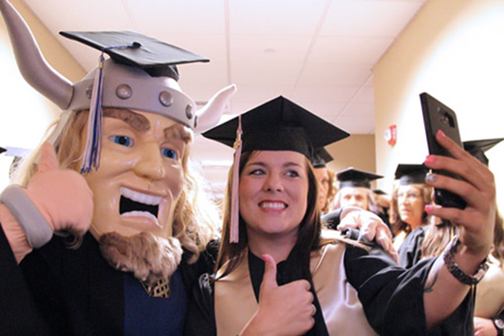
Nuts & Bolts
11th grade courses will be offered either at the high school site or at SJR State or online, depending upon instructor availability.
In order to complete the AA, during the summer between 11th and 12th grade AND during the senior year, students must be taking a full course load at SJR State’s campus. Students are encouraged to continue to participate in extracurricular activities at the high school, but they may not be taking additional coursework at the high school site as well as a full load of college courses.
Transportation to and from SJR State’s Campus is the responsibility of the student/family.

Slide 13
Nuts & Bolts
College courses taught at the high school site are exactly like the college courses taught on SJR State’s campuses—they are just being taught somewhere else. The student’s SJR State college transcript will not show any indication that the course was taken at a high school site rather than on a college campus.
College courses taught at the high school site will use the same textbook, course outline, and learning outcomes as if the courses were being taught on SJR State’s campus. The faculty have the same credentials and are evaluated by SJR State staff to ensure the course outcomes are being met.

Slide 14
Who Pays for This?
Dual enrollment students and parents are statutorily exempt from the payment of all tuition, textbook, and fees.
The St. Johns County School District is not charged tuition for courses taught at the high school site or summer courses. SJR State in-state tuition is $108/credit hour. The School District pays SJR State a discounted tuition rate of $71.98/credit for dual enrollment at SJR State’s campus & online. Dual enrollment students and parents pay nothing.
The St. Johns County School District receives full FTE for all dual enrollment students, even when students are enrolled full time at SJR State’s campus and taking no courses at the high school. Tuition for 33 credits during senior year will be $2,375, well below the $7K+ FTE the student will generate for the District.
This is a true financial partnership between the College and the District that benefits students and the community.

Slide 15
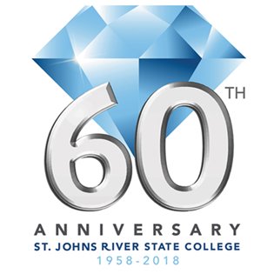
So What’s the Downside?
  Once you are in 12th grade and taking all of your classes on SJR State’s campus, you will truly be just like any other college student.
  The college calendar is often not the same as the high school calendar. In the 12th grade, if the college is open and if you are taking a class on our campus, you will be expected to attend class at SJR State’s campus.
  It is the student’s responsibility to contact the professor if you are having difficulty in the course or to notify the instructor of an absence.

Slide 16

So What’s the Downside?
  These are “real” College Courses—students’ college GPA and transcripts never go away.
  Students must have the social and emotional maturity to handle college level coursework and a college classroom.
  Students need to be ready to declare their college major when they are a senior in high school.

Slide 17
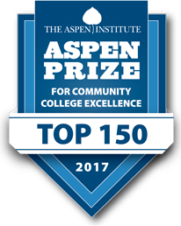
And the Upside?
The Collegiate High School will be rigorous and will provide you with academic challenge and enable you to develop your critical thinking and higher order thinking skills.
The Collegiate High School will provide you with exposure to a college campus and college environment while you are still in high school.

Slide 18
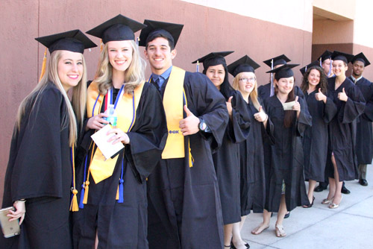
And the Upside?
The Collegiate High School is an accelerated pathway to your college degree/degrees
  There is a clear correlation between educational attainment and earnings and educational attainment and the unemployment rate.
  Particularly if you have aspirations to pursue a Bachelor’s Degree or higher and are focused and have an idea of the field you are interested in studying, the Collegiate High School is an excellent way of moving you towards your goal more quickly—and it will save you money.

Slide 19

And the Upside?

Slide 20
And the Upside?
What will Bright Futures cover?
“A Florida Academic Scholar (FAS) or Florida Medallion Scholar (FMS) may receive funding for up to five years from high school graduation for a maximum of 120 semester hours (or equivalent) toward the completion of a certificate or a first baccalaureate degree. This also applies to students in 3/2 programs who are classified as an undergraduate.” (Bright Futures Student Handbook Ch 2, pg 3)
“A FAS or FMS scholarship recipient, who graduates with a baccalaureate degree in seven or fewer semesters, or in 105 semester hours or fewer, may receive funding for one semester of graduate study, not to exceed 15 credit hours paid at the undergraduate rate. Graduate school funding must be used within the student’s five year award timeframe (within five years from high school graduation).” (BFSH Ch 2, pg 6)
http://www.floridastudentfinancialaid.org/ssfad/PDF/BFHandbookChapter2.pdf

Slide 21
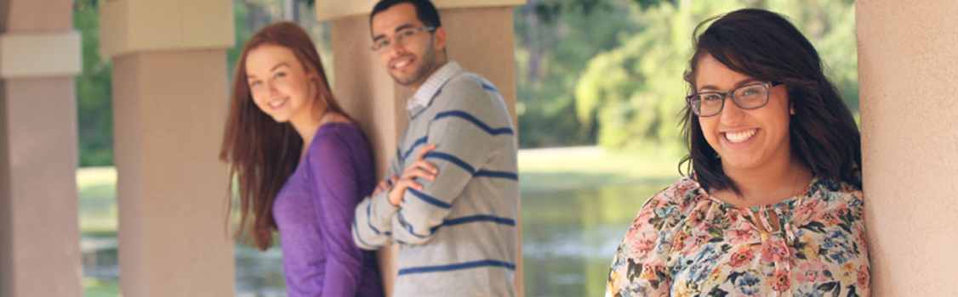
And the Upside?
Significant Savings for Students
2017-2018 SJR State In-State Tuition $108/credit hour
$108/Credit Hour X 60 Credits = $6,480
Approximate Textbook cost for 60 credits = $2,840
Total Tuition & Textbook Savings Per Student: $9,320

Slide 22
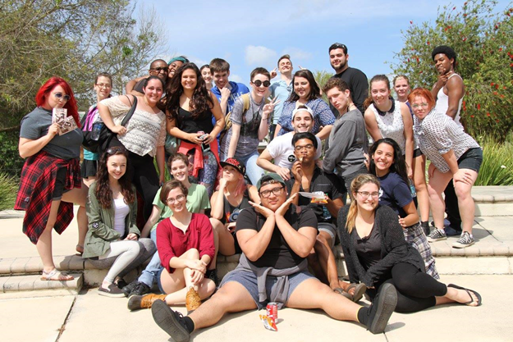
How Will Students Be Selected?
All eligible students must apply to be in the collegiate high school by the deadline of 4:00pm February 16, 2018 . Thirty students will be accepted per high school. If the number of eligible students who apply exceeds the number of seats allocated for the program, a lottery will be applied for final selection.
The lottery would occur during the week of February 19th and acceptance or denial letters will be sent out the week of February 23rd.
See Admissions & Lottery Process document for complete details.

Slide 23
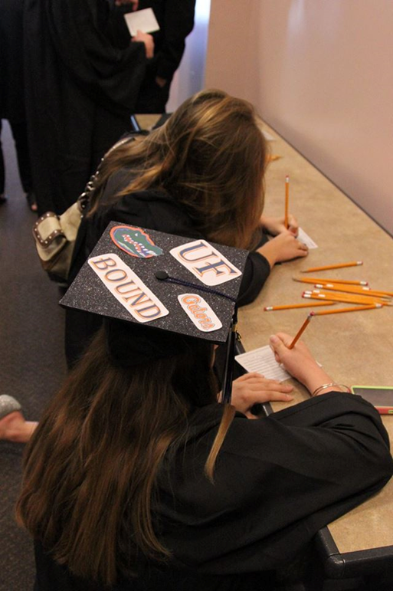
Questions & For More Information
St. Johns River State College
Office of Dual Enrollment
(386) 312-4136
dualenrollment@sjrstate.edu
St. Johns County School District
Department of Guidance and Choice
(904) 547-7754

