Slide 1
Time to think about high school
Notes:
NOTE: Want a different image on this slide? Select the picture and delete it. Now click the Pictures icon in the placeholder to insert your own image.

Slide 2
What is an Academy?
Focused courses in a specific area
A small learning community within the school
Real-world experience to prepare you for the jobs of tomorrow
Hands-on projects (Project-based learning)
Can help you in choosing your college major early

Slide 3
Typical 9th Grade Schedule
Standard | Advanced
English 1 | English 1 Honors
Algebra 1 | Geometry, Geometry Honors or Alg 2 Honors
Environmental Science | Environmental Science Honors or Biology Honors
World History | World History Honors or AP World History
HOPE | HOPE
Elective | Elective
Academy Course | Academy Course
Notes:
Customize to match your high school

Slide 4
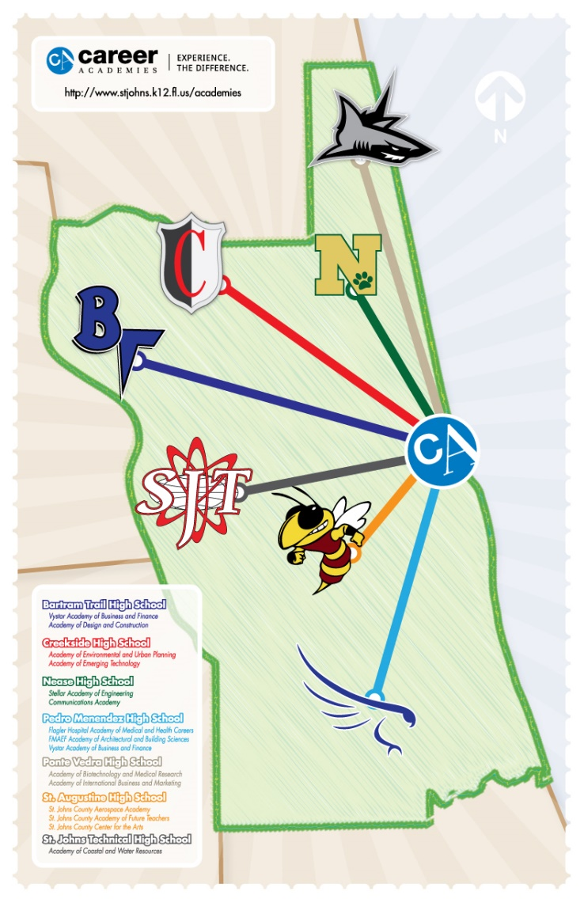
What are your Choices?
Bartram Trail
Creekside
Nease
Pedro Menendez
Ponte Vedra
Saint Augustine
Saint Johns Technical

Slide 5
Watch Videos On All the Programs
Learn about every Academy at every school!
https://academies.stjohns.k12.fl.us/videos/

Slide 6
HIGH SCHOOL SHOWCASE
Thursday, January 24th, 2019
3:30 p.m. to 7:00 p.m.
At World Golf Village Conference Center

Slide 7
Pedro Menendez High School
Flagler Hospital Academy of Medical & Health Careers
Academy of Architectural & Building Sciences
Building Construction
Drafting
VyStar Academy of Business & Finance
Business
Finance
Digital Design
International Baccalaureate (IB)
Career Specialist, Christine Danner
904-547-8681 or christine.danner@stjohns.k12.fl.us

Slide 8
St. Augustine High School
St. Johns County Aerospace Academy
St. Johns County Academy of Future Teachers
Academy of Law & Homeland Security
St. Johns County Center for the Arts
Band, Ceramics, Chorus, Dance, Digital Art, Draw/Paint, Drama, Guitar, Musical Theatre, Piano
Cambridge AICE Program
Army JROTC
Career Specialist, Katie Maltby
904-547-8538 or
Katie.maltby@stjohns.k12.fl.us

Slide 9
St Johns Technical High School
Academy of Coastal & Water Resources
Academy of Culinary Arts
Career Specialist, Linda Krepp
904-547-8130 or linda.krepp@stjohns.k12.fl.us

Slide 10
Creekside High School
Academy of Engineering and Environmental Sciences
Engineering
Environmental Science
Academy of Emerging Technology
Digital Media Technology
Cybersecurity
Career Specialist, Daryl Cullipher
904-547-7309 or daryl.cullipher@stjohns.k12.fl.us

Slide 11
Bartram Trail High School
Design Academy
Fashion
Interior
Architecture
VyStar Academy of Business & Finance
Finance
Entrepreneurship
Information Technology Academy
Air Force Junior ROTC
Career Specialist, Michelle Kisch
904-547-8380 or michelle.kisch@stjohns.k12.fl.us

Slide 12
Ponte Vedra High School
Academy of Biotechnology & Medical Research
Academy of International Business & Marketing
Marketing
Business
Academy of Information Technology
Career Specialist, Mari Ellen Asplen
904-547-7376 or mariellen.asplen@stjohns.k12.fl.us

Slide 13
Allen D. Nease High School
Communications Academy
TV Production
Sports Media
Digital Design
Stellar Academy of Engineering
Academy of Hospitality and Tourism
International Baccalaureate (IB)
Naval JROTC
Career Specialist, Jaime Combs
904-547-8306 or
jaime.combs@stjohns.k12.fl.us

Slide 14
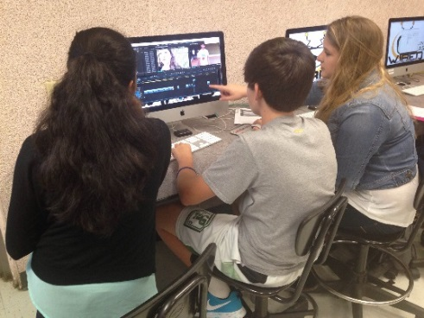
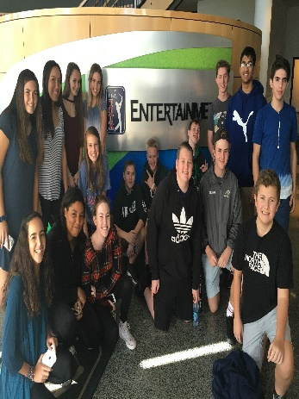
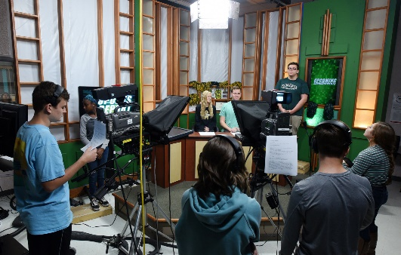
Communications Academy
Currently over 500 students
TV Production News, Sports Media, & Digital Design
Produce Wired: our daily, award-winning newscast
Learn ESPN-style editing techniques to cut sports highlights
Compete nationally at the Student Television Network Convention
Digital Design students learn web design, graphic arts principles, and Adobe software

Slide 15
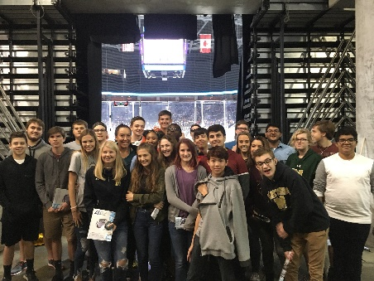
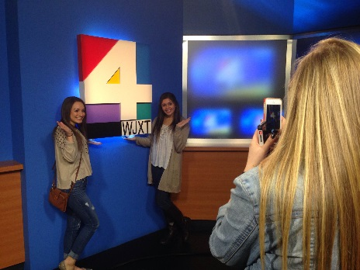
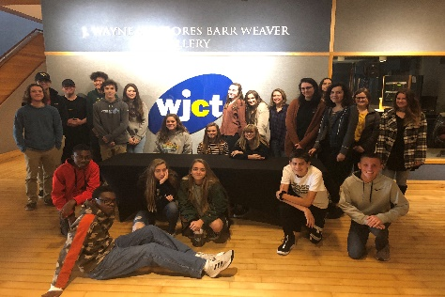
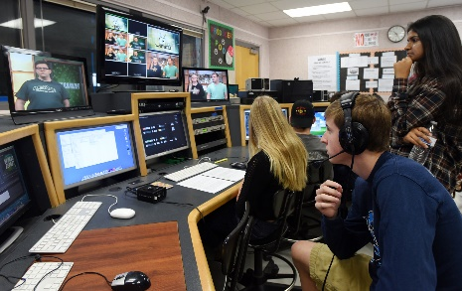
Communications Academy
Guest Speakers and Field Trips through the year (PGA Tour Entertainment, Leonard’s, WJXT Studios)
Creative, hands-on learning –create graphic design and video projects in class
Earn industry certifications in Photoshop, Illustrator, InDesign, Premiere Pro

Slide 16
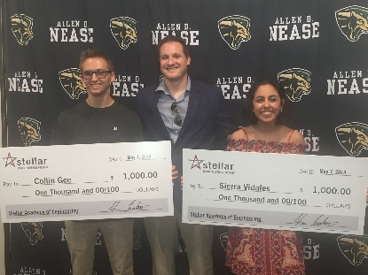
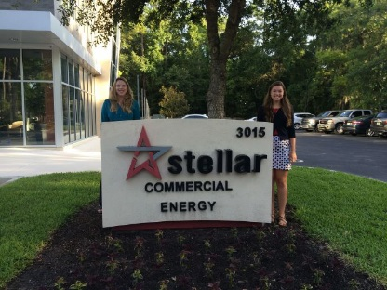
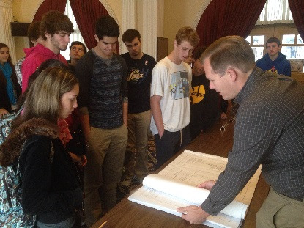
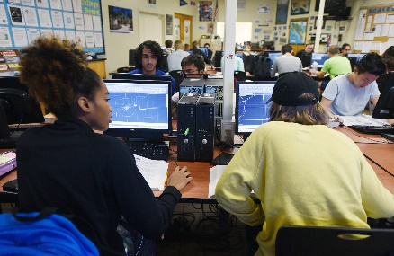
Stellar Academy of Engineering
Currently includes over 300 students
What makes us unique? You’ll study multiple fields of Engineering in one program: Architectural, Mechanical, Civil, and more
We partner with Stellar, a global design and engineering firm to provide unique opportunities and curriculum

Slide 17
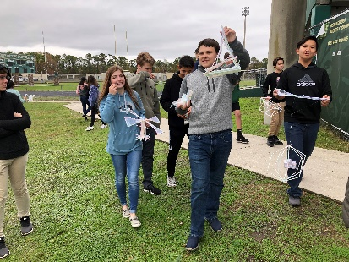
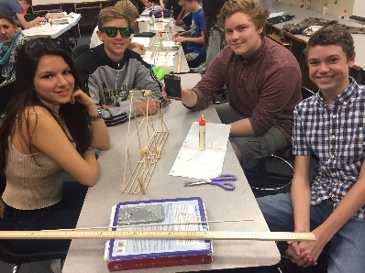
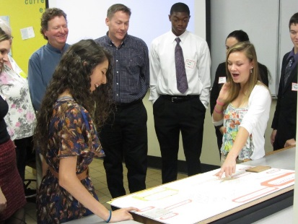
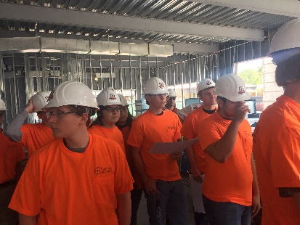
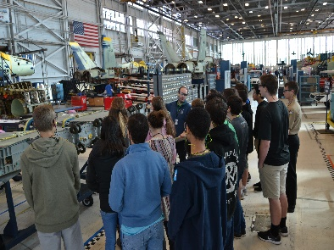
Stellar Academy of Engineering
Earn a professional certification in AutoCAD, Revit, Inventor before you graduate
Field Trips throughout the year (NAS-Jax, Sally Corporation, UNF College) and guest speakers who work in engineering
Hands-on, project based learning

Slide 18
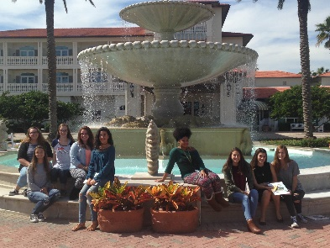
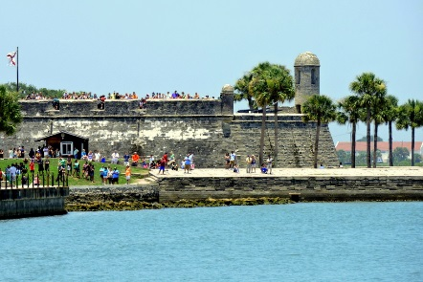
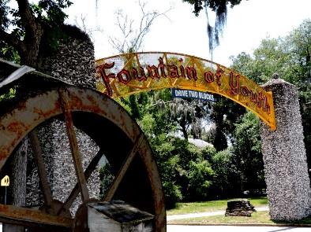
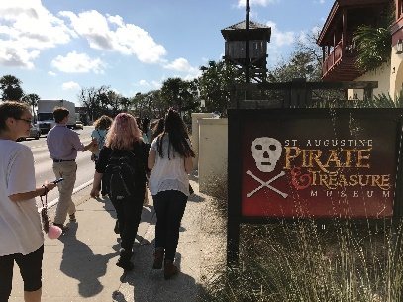
St. Johns County Academy of Hospitality and Tourism
Over 130 students enrolled
Hospitality and tourism is one of the world’s fastest-growing career paths
A career in hospitality can include management jobs in a bustling hotel in a big city, a tourist attraction or museum, a city’s visitor bureau, a beachside timeshare resort, a bed and breakfast, a cruise ship, a spa, a restaurant, even an elegant private club

Slide 19
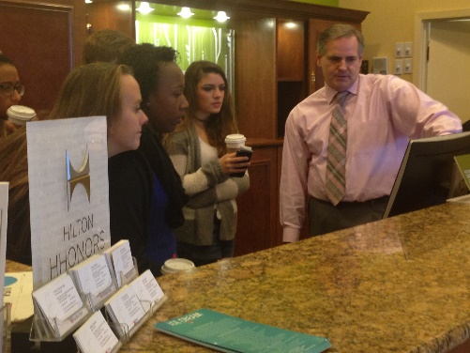
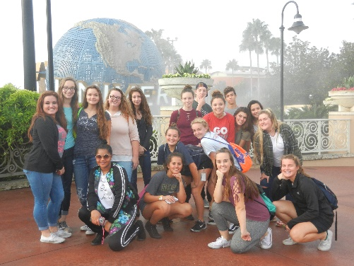
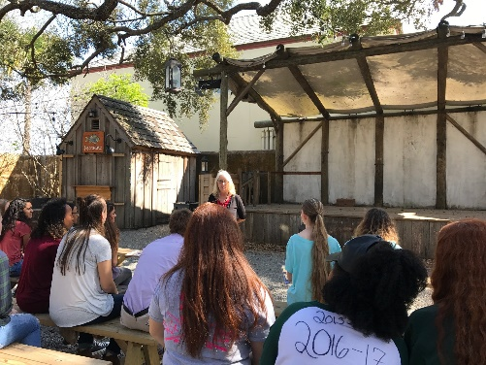
St. Johns County Academy of Hospitality and Tourism
The Academy focuses on computer, business, and customer service skills, required for a successful career in Hospitality and Tourism.
Learn skills in class, see them in action on field trips, utilize them in on-the-job internships

Slide 20
International Baccalaureate Program
Mrs. Kennedy, IB Coordinator
Nease Pre-IB Program in 9th & 10th Grade
Pre-IB is a course of study that prepares students for the “real” IB Program which is junior and senior years of high school.
Pre-IB courses are a level above honors and require a lot of hard work.
Pre-IB is for motivated and hard working students who like school and like to learn.

Slide 21
Characteristics of an IB Student
International Baccalaureate Program
Motivated
Dedicated
Desire to Learn
Sense of Responsibility
Sense of Humor
Desire to Succeed
Manage Time Wisely
Passionate
Organized
Focused
Open-minded
Hard Worker
Strong in all subjects
Well-rounded
Multi-Tasker

Slide 22
Typical Schedule for 9th Grade Pre-IB Students
English 1- Pre-IB
AP World History
Biology 1 – Pre-IB
Geometry Honors or Algebra 2 Honors
Foreign Language – either French or Spanish
2 electives

Slide 23
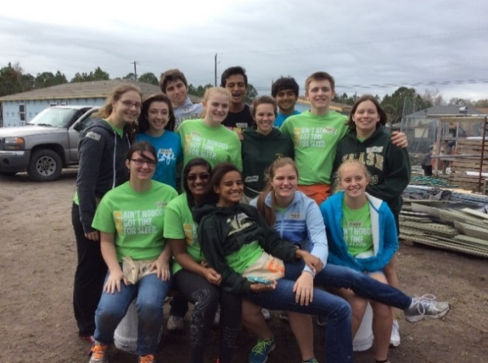
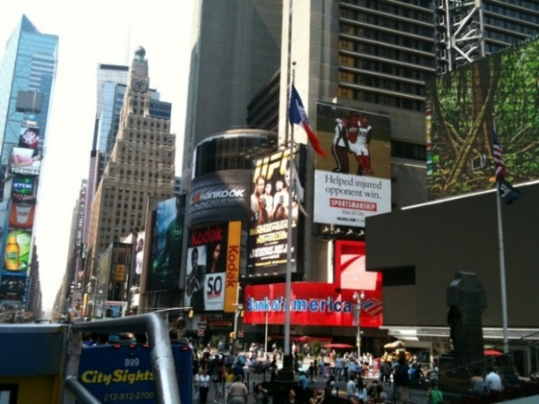
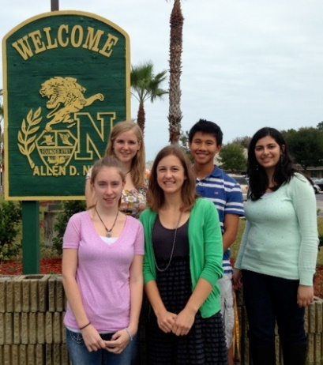
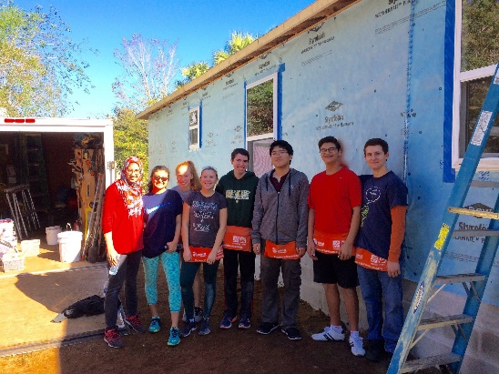
Field Trips & Activities
Class Service Projects, New York City, IB Socials and more!

Slide 24
Navy JROTC
Captain LaRochelle
Master Chief Spears
Gunnery Sergeant Hanson
2015 #1 Program in the Nation 2018 #1 Program in northern Florida & Georgia
Opportunity for Service Academy
And ROTC Scholarships
Earn promotions & medals
Amazing Field Trips
Orienteering Team
Marksmanship Team
Drill Team
Athletic Team
Academic Team
No future military requirement
*Nease-zoned students wanting to apply to JROTC cannot attend Bartram or St. Augustine for JROTC only. If students are zoned for Bartram or St. Augustine, they cannot attend Nease for the JROTC program only.

Slide 25
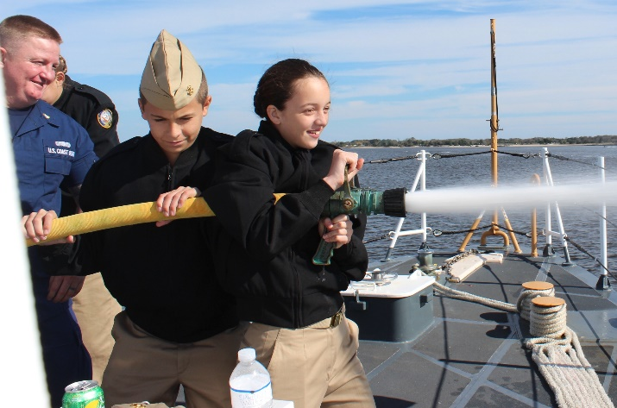
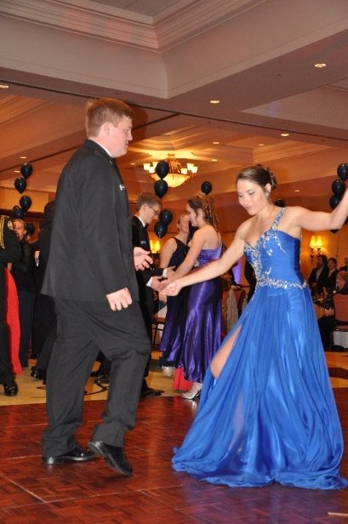
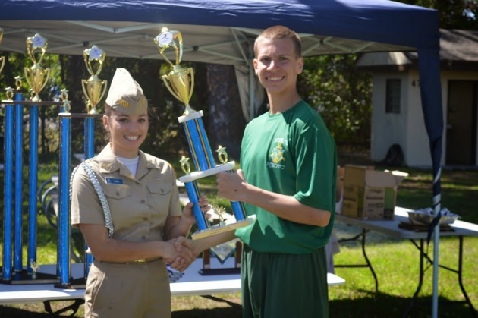
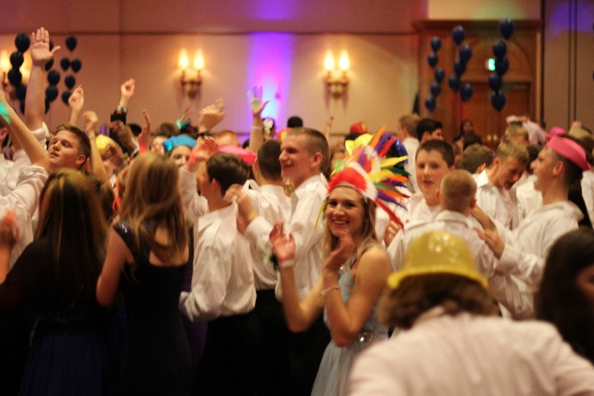
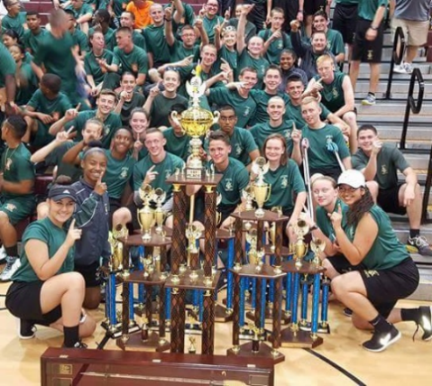
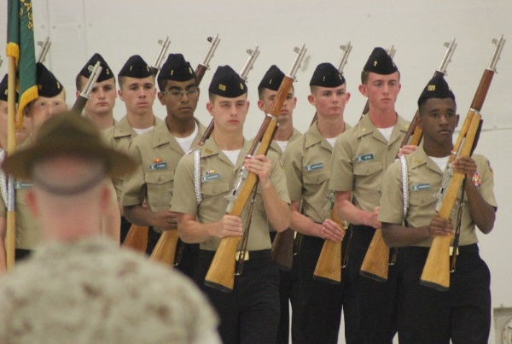
Competitions and Special Events
*All NJROTC New Cadets must participate in Summer Training: 25-26 July (Thurs-Fri) and then 29 July-2 August (M-F).

Slide 26
HIGH SCHOOL SHOWCASE
Thursday, January 24th , 2019
3:30 p.m. to 7:00 p.m.
At World Golf Village Conference Center

Slide 27
High School Academy Nights
January 31 – Bartram Trail
January 29 – St. Johns Technical
January 29 – St. Augustine
(Arts Auditions at SAHS will occur on February 15 at 5PM. Must audition AND apply on-line.)
January 30 – Allen D. Nease
February 4 – Creekside
February 5 – Pedro Menendez
February 5 – Ponte Vedra

Slide 28
Academy/Program of Choice Application Window
On-line application via the Student’s Home Access Center (HAC) account is available from Jan. 24th – Feb. 19th at 5:00 pm
Once the application window opens on January 24th, application information and step-by-step directions available at neaseacademies.com or academies.stjohns.k12.fl.us

Slide 29
Academy/Program of Choice Application Window
NOTES:
Students can apply for up to 3 Programs of Choice, but must rank 1st, 2nd, 3rd
It IS possible to be accepted to two programs at the same school, but you won’t be accepted to two programs at two different schools
Students must provide their own transportation if attending an out-of-zone school.
IB and AICE programs require teacher recommendations. St. Johns County Center for the Arts requires auditions

Slide 30
HIGH SCHOOL SHOWCASE
Thursday, January 24th , 2019
3:30 p.m. to 7:00 p.m.
At World Golf Village Conference Center

